Slide 1

Inventory Management:
Safety Inventory (II)
第七單元：Inventory Management: Safety Inventory (II)
郭瑞祥教授
【本著作除另有註明外，採取創用CC「姓名標示－非商業性－相同方式分享」台灣3.0版授權釋出】
1

Slide 2
Two Managerial Levers to Reduce Safety Inventory
Safety inventory increases with an increase in the lead time and
the standard deviation of periodic demand.
Reduce the supplier lead time (L)
  If lead time decreases by a factor of k, safety inventory in the retailer decreases by a factor of .
  It is important for the retailer to share some of the resulting benefits to the supplier.
Reduce the underlying uncertainty of demand ( σ_{D} )
  If σ_{D} is reduced by a factor of k, safety inventory decreases by a factor of k.
  The reduction in σ_{D} can be achieved by reducing forecast uncertainty, such as by sharing demand information through the supply chain.
2

Slide 3
Impact of Supply (Lead time) Uncertainty on Safety Inventory
Assume demand per period and replenishment lead time are normally distributed
D:Average demand per period
σ_{D}:Standard deviation of demand per period (demand uncertainty)
L: Average lead time for replenishment
S_{L}:Standard deviation of lead time (supply uncertainty)
Consider continuous review policy, we have:
Demand during the lead time is N(D_{L},σ_{L}²)
3

Slide 4
Example
Suppose we have
Required safety inventory,
A reduction in lead time uncertainty can help reduce
safety inventory
S_{L} | σ_{L} | ss(units) | ss(days)
6 | 15,058 | 19,298 | 7.72
5 | 12,570 | 16,109 | 6.44
4 | 10,087 | 12,927 | 5.17
3 | 7,616 | 9,760 | 3.90
2 | 5,172 | 6,628 | 2.65
1 | 2,828 | 3,625 | 1.45
0 | 1,323 | 1,695 | 0.68
4

Slide 5
Impact of Supply (Lead time) Uncertainty on Safety Inventory
Assume demand per period and replenishment lead time are normally distributed
D:Average demand per period
σ_{D}:Standard deviation of demand per period (demand uncertainty)
L: Average lead time for replenishment
S_{L}:Standard deviation of lead time (supply uncertainty)
Consider continuous review policy, we have:
Demand during the lead time is N(D_{L},σ_{L}²)
5

Slide 6
Proof
Assume the following random variables:
Expected value of a random sum of random variables
6

Slide 7
Proof
Assume the following random variables:
Expect value of a random sum of random variables
i
i
7

Slide 8
Proof - Continued
Variance of a random sum of random variables
First find E(d²)
8

Slide 9
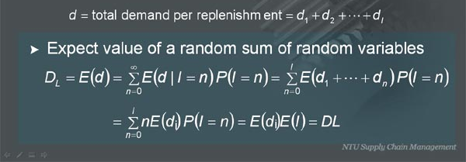
Proof - Continued
Now the square of the mean
Now the variance
9

Slide 10
Example
Suppose we have
Required safety inventory,
A reduction in lead time uncertainty can help reduce
safety inventory
S_{L} | σ_{L} | ss(units) | ss(days)
6 | 15,058 | 19,298 | 7.72
5 | 12,570 | 16,109 | 6.44
4 | 10,087 | 12,927 | 5.17
3 | 7,616 | 9,760 | 3.90
2 | 5,172 | 6,628 | 2.65
1 | 2,828 | 3,625 | 1.45
0 | 1,323 | 1,695 | 0.68
10

Slide 11
Quick Response Initiatives
Reduce information uncertainty in demand
Reduce replenishment lead time
Reduce supply uncertainty or replenishment lead time uncertainty
Increase reorder frequency or adapt continuous review
11

Slide 12
Accurate Response Initiatives
Physical centralization (inventory pooling)
Information centralization
Specialization
Product substitution
Component commonality + postponement
12

Slide 13
Impact of Inventory Pooling
Which of the two systems provides a higher level of service
for a given level of safety stock?
System A (Decentralized)
System B (Centralized)
13

Slide 14
Factors Affecting Value of Inventory Pooling
Demand Correlation
Coefficient of variation of demand
Product value
Transportation cost
14

Slide 15
Impact of Correlation on Inventory Pooling
15

Slide 16
Impact of Correlation on Inventory Pooling
System A (Decentralized)
System B (Centralized)
Aggregation reduces the standard deviation (which is
proportional to safety inventory) only if demand across the
regions being aggregated is not perfectly positively
correlated.
16

Slide 17

Example
Suppose we have (for each outlet store)
D = 25(cars/week)
σ_{D} = 5(cars)
L = 2 weeks
CSL=0.9
Microsoft。
Required safety inventory in each outlet store
Suppose
17

Slide 18
Example - Continued
Safety Inventory in the disaggregate and aggregate options
ρ | Disaggregate Safety Inventory | Aggregate Safety Inventory
0 | 36.24 | 18.12
0.2 | 36.24 | 22.92
0.4 | 36.24 | 26.88
0.6 | 36.24 | 30.32
0.8 | 36.24 | 33.41
1.0 | 36.24 | 36.24
18

Slide 19
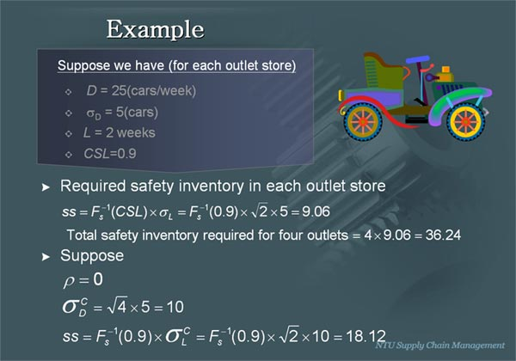
Square Root Law
If number of independent stocking locations decreases by a
factor of n, the average safety inventory is expected to decrease by a factor of .
Microsoft。
Total Safety
Inventory
Number of Independent
Stocking Locations
19

Slide 20
Impact of Coefficient of Variation and Product Value on Inventory Pooling
Suppose a supplier has 1,600 stores
Two products
  Electric motors : $500
  Cleaner : $30
Weekly demand
  Electric motors is N(20,40²)
  Cleaner is N(1000,100²)
Holding cost is 25 percent of product value
CSL=0.95
L = 4 weeks
20

Slide 21
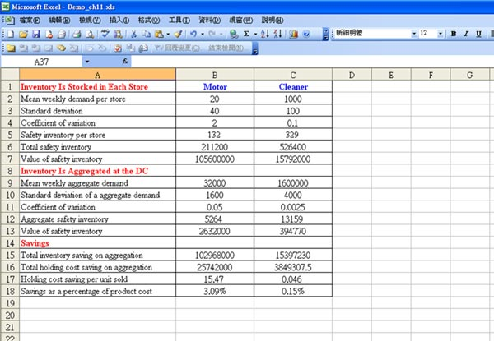
Value of Aggregation
 | Motors | Cleaner
Inventory Is Stocked in Each Store
Mean weekly demand per store | 20 | 1,000
Standard deviation | 40 | 100
Coefficient of variation | 2.0 | 0.1
Safety inventory per store | 132 | 329
Total safety inventory | 211,200 | 526,400
Value of safety inventory | $105,600,000 | $15,792,000
Inventory Is Aggregated at the DC
Mean weekly aggregate demand | 32,000 | 1,600,000
Standard deviation of a aggregate demand | 1,600 | 4,000
Coefficient of variation | 0.05 | 0.0025
Aggregate safety inventory | 5,264 | 13,159
Value of safety inventory | $2,632,000 | $394,770
Savings
Total inventory saving on aggregation | $102,968,000 | $15,397,230
Total holding cost saving on aggregation | $25,742,000 | $3,849,308
Holding cost saving per unit sold | $15.47 | $0.046
Savings as a percentage of product cost | 3.09% | 0.15%
The higher the coefficient of variation (and product value), the greater the reduction in safety inventory as a result of centralization.
B3/B2
=NORMSINV(0.95)*SQRT(4)*40
=132*1600
=211200*500
21
臺灣大學 郭瑞祥老師
Notes:
=NORMSINV(0.95)*SQRT(4)*40

Slide 22
Value of Aggregation
 | Motors | Cleaner
Inventory Is Stocked in Each Store
Mean weekly demand per store | 20 | 1,000
Standard deviation | 40 | 100
Coefficient of variation | 2.0 | 0.1
Safety inventory per store | 132 | 329
Total safety inventory | 211,200 | 526,400
Value of safety inventory | $105,600,000 | $15,792,000
Inventory Is Aggregated at the DC
Mean weekly aggregate demand | 32,000 | 1,600,000
Standard deviation of a aggregate demand | 1,600 | 4,000
Coefficient of variation | 0.05 | 0.0025
Aggregate safety inventory | 5,264 | 13,159
Value of safety inventory | $2,632,000 | $394,770
Savings
Total inventory saving on aggregation | $102,968,000 | $15,397,230
Total holding cost saving on aggregation | $25,742,000 | $3,849,308
Holding cost saving per unit sold | $15.47 | $0.046
Savings as a percentage of product cost | 3.09% | 0.15%
The higher the coefficient of variation (and product value), the greater the reduction in safety inventory as a result of centralization.
=20*1600
=SQRT(1600)*40
=B10/B9
=NORMSINV(0.95)*SQRT(4)*1600
=5264*500
22
臺灣大學 郭瑞祥老師
Notes:
=NORMSINV(0.95)*SQRT(4)*40

Slide 23
Value of Aggregation
 | Motors | Cleaner
Inventory Is Stocked in Each Store
Mean weekly demand per store | 20 | 1,000
Standard deviation | 40 | 100
Coefficient of variation | 2.0 | 0.1
Safety inventory per store | 132 | 329
Total safety inventory | 211,200 | 526,400
Value of safety inventory | $105,600,000 | $15,792,000
Inventory Is Aggregated at the DC
Mean weekly aggregate demand | 32,000 | 1,600,000
Standard deviation of a aggregate demand | 1,600 | 4,000
Coefficient of variation | 0.05 | 0.0025
Aggregate safety inventory | 5,264 | 13,159
Value of safety inventory | $2,632,000 | $394,770
Savings
Total inventory saving on aggregation | $102,968,000 | $15,397,230
Total holding cost saving on aggregation | $25,742,000 | $3,849,308
Holding cost saving per unit sold | $15.47 | $0.046
Savings as a percentage of product cost | 3.09% | 0.15%
The higher the coefficient of variation (and product value), the greater the reduction in safety inventory as a result of centralization.
=B7-B13
=B15*0.25
=B16/(32000*52)
23
臺灣大學 郭瑞祥老師
Notes:
=NORMSINV(0.95)*SQRT(4)*40

Slide 24
Value of Aggregation
 | Motors | Cleaner
Inventory Is Stocked in Each Store
Mean weekly demand per store | 20 | 1,000
Standard deviation | 40 | 100
Coefficient of variation | 2.0 | 0.1
Safety inventory per store | 132 | 329
Total safety inventory | 211,200 | 526,400
Value of safety inventory | $105,600,000 | $15,792,000
Inventory Is Aggregated at the DC
Mean weekly aggregate demand | 32,000 | 1,600,000
Standard deviation of a aggregate demand | 1,600 | 4,000
Coefficient of variation | 0.05 | 0.0025
Aggregate safety inventory | 5,264 | 13,159
Value of safety inventory | $2,632,000 | $394,770
Savings
Total inventory saving on aggregation | $102,968,000 | $15,397,230
Total holding cost saving on aggregation | $25,742,000 | $3,849,308
Holding cost saving per unit sold | $15.47 | $0.046
Savings as a percentage of product cost | 3.09% | 0.15%
The higher the coefficient of variation (and product value), the greater the reduction in safety inventory as a result of centralization.
24
Notes:
=NORMSINV(0.95)*SQRT(4)*40

Slide 25
Impact of Transportation on Inventory Pooling
Negative impact
  Increase response time
  Increase transportation cost
Practices to reduce the negative impact
  Gap : use small retailer outlets
  McMaster-Carr : use more warehouses
Microsoft。
CoolCLIPS網站
25

Slide 26
Information Centralization
Use information centralization to virtually aggregate inventory
across all warehouses or stores even though the inventory is
physically separated.
Benefits
  Orders are filled from the warehouse or store closest to the customer, keeping transportation cost low.
Examples
Microsoft。
  Wholesales : McMaster Carr use information centralization to pick up products from the closest warehouse
  Retailer : Gap uses information centralization to pick up products from the closest store
  Retailer : Wal-Mart use information centralization to exchange products between stores
Microsoft。
26

Slide 27
Specialization
- Allocation of Products to Stocking Locations -
A product that does not sell well in a geographical region should not be carried in inventory by the warehouse or retail store located there.
If aggregation reduces the required safety inventory by a large amount, it is better to carry the product in one central location. If not, it is better to carry the product in multiple decentralization locations to reduce response time and transportation cost.
Slow-moving items are better distributed by a centralization location.
Fast-moving items are better distributed by decentralization locations.
High-value items provide a greater benefit from centralization than low-value items.
Emergency item should be located close to customers.
Microsoft。
27

Slide 28
Product Substitution
Substitution refers to the use of one product to satisfy demand for a different product.
Manufacturer-Driven One-Way Substitution
  Aggregating demand across the products reduces safety inventory.
  Value of substitution increases as demand uncertainty increases.
  If the cost differential between two products is very small, substitution is preferred. As the cost differential increases, the benefit of substitution decreases.
  If demand between two products is strongly positively correlated, there is little value in substitution.
28

Slide 29
Customer-Driven Two-Way Substitution
Recognition of customer-driven substitution and joint management of inventory across substitutable products allow a supply chain to reduce the required safety inventory.
In a retailing store, substitute products should be placed near each other. In the online channel, substitution requires a retailer to present the availability of substitute products if the one the customer requests is out of stock.
The greater the demand uncertainty, the greater the benefit of substitution. The lower the correlation of demand between substitutable products, the greater the benefit form exploiting substitution.
29

Slide 30

Component Commonality
When common components are designed across different finished products, the demand for each component is then an aggregation of the demand for all the finished products. Component demand is thus more predictable than the demand for any one finished product.
As a component is used in more finished products, it needs to be more flexible. As a result, the cost of producing the component typically increases with increasing commonality.
Component commonality reduces the safety inventory required. The marginal benefit, however, decreases with increasing commonality.
VECTORLOGO。
Microsoft。
30

Slide 31

Example
Suppose Dell manufactures 27 different PCs, with three distinct components : processor, memory, and hard drive.
In the disaggregate option, Dell designs 3*27=81 distinct components.
In the common component option, Dell designs 3 distinct processors, 3 memory units, and 3 hard drives. Each component is thus used in 9 different PCs.
Suppose for each PC, the monthly demand is N(5000,3000²)
The replenishment lead time for each component is one month.
CSL=0.95
Microsoft。
31
Microsoft。
Microsoft。
Wikipedia

Slide 32
Example - Continued
Disaggregate option
Safety inventory for each component =
Component commonality option
Standard deviation of demand of common component
across 9 products
Safety inventory per common component =
32

Slide 33
Marginal Benefit of Component Commonality
Number of Finished Products per Component | Safety Inventory | Marginal Reduction in Safety Inventory | Total Reduction in Safety Inventory
1 | 399,699
2 | 282,630 | 117,069 | 117,069
3 | 230,766 | 51,864 | 168,933
4 | 199,849 | 30,917 | 199,850
5 | 178,751 | 21,098 | 220,948
6 | 163,176 | 15,575 | 236,523
7 | 151,072 | 12,104 | 248,627
8 | 141,315 | 9,757 | 258,384
9 | 133,233 | 8,082 | 266,466
33

Slide 34
Postponement
Postponement is the ability of a supply chain to delay product differentiation or customization until closer to the time the product is sold.
The goal is to have common components in the supply chain for most of the push phase and move product differentiation as close to the pull phase of the supply chain as possible.
Dell uses assemble-to-order for its postponement strategy.
Benetton switches the production sequence to postpone the color customization of the knit garments.
Postponement allows a supply chain to exploit aggregation to reduce safety inventories without hurting product availability.
34

Slide 35
Supply Chain Flows with Postponement
Supply chain flows without postponement
Supply chain flows with component
commonality and postponement
35

Slide 36
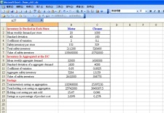
版權聲明
頁碼 | 作品 | 授權條件 | 作者/來源
17, 19 |  |  | 本作品轉載自Microsoft Office 2007多媒體藝廊，依據Microsoft 服務合約及著作權法第46、52、65條合理使用。
21 |  |  | 臺灣大學 郭瑞祥老師
22 |  |  | 臺灣大學 郭瑞祥老師
23 |  |  | 臺灣大學 郭瑞祥老師
25 |  |  | 本作品轉載自Microsoft Office 2007多媒體藝廊，依據Microsoft 服務合約及著作權法第46、52、65條合理使用。
25 |  |  | 本作品轉載自CoolCLIPS網站(http://dir.coolclips.com/Structures/Common_Dwellings/Apartments_Condominiums/shopping_center_and_parking_lot_arch0399.html)，瀏覽日期2012/1/9。依據著作權法第46、52、65條合理使用。
26 |  |  | 本作品轉載自Microsoft Office 2007多媒體藝廊，依據Microsoft 服務合約及著作權法第46、52、65條合理使用。
36

Slide 37
版權聲明
頁碼 | 作品 | 授權條件 | 作者/來源
26 |  |  | 本作品轉載自Microsoft Office 2007多媒體藝廊，依據Microsoft 服務合約及著作權法第46、52、65條合理使用。
27 |  |  | 本作品轉載自Microsoft Office 2007多媒體藝廊，依據Microsoft 服務合約及著作權法第46、52、65條合理使用。
30 |  |  | 本作品轉載自Microsoft Office 2007多媒體藝廊，依據Microsoft 服務合約及著作權法第46、52、65條合理使用。
30 |  |  | VECTORLOGO(http://www.allfreelogo.com/logo/hp-logo.html) 本作品轉載自VECTORLOGO網站，依據其版權聲明(http://www.allfreelogo.com/privacy-policy/)與著作權法第46、52、65條合理使用。
31 |  |  | 本作品轉載自clipartoday網站 ( http://www.clipartoday.com/clipart/objects/objects/tools_184085.html ) ，瀏覽日期2012/1/9。依據著作權法第46、52、65條合理使用。
31 |  |  | Wikimedia Commons 本作品轉載自http://commons.wikimedia.org/wiki/File:Dell_Logo.png，瀏覽日期2011/12/28。
37

Slide 38
版權聲明
頁碼 | 作品 | 授權條件 | 作者/來源
31 |  |  | 本作品轉載自Microsoft Office 2007多媒體藝廊，依據Microsoft 服務合約及著作權法第46、52、65條合理使用。
38

