Slide 1
實驗經濟學一：行為賽局論 Experimental Economics I: Behavioral Game Theory 第十二講：神經經濟學導論 Lecture 12: Neuroeconomics: An Introduction
授課教師：國立臺灣大學 經濟學系 王道一教授（Joseph Tao-yi Wang ）
本課程指定教材: Colin E. Camerer, Behavioral Game Theory: Experiments in
Strategic Interaction. New York: Russell Sage Foundation; New Jersey:
Princeton UP, 2003.
【本著作除另有註明外，採取創用CC「姓名標示－非商業性－相同方式分享」臺灣3.0版授權釋出】

Slide 2
Outline
Colin F. Camerer (2007), “Neuroeconomics: Using Neuroscience to Make Economic Predictions,” Economic Journal, 117, C26-C42.
Introduction
Neuroscientific Facts and Tools
Neuro evidence about economic behavior:
Evidence for rational choice principles
Evidence for behavioral economics principles
Evidence for new psychological variables
Conclusion

Slide 3
Introduction
What is Neuroeconomics? It…
Seeks to ground microeconomic theory in details about how the brain work
Subfield of behavioral economics and experimental economics
Supplies theories and experimental designs for neuroscience (to study higher-order cognition)
Essentially, it uses Neuroscience methods to investigate Economic (Cognitive) questions
Economics + Neuroscience + Psychology

Slide 4
Introduction
Is this a sharp turn in economic thought?
Back in 1900, maybe yes…
Pareto (1897)
"It is an empirical fact that the natural sciences have progressed only when they have taken secondary principles as their point of departure, instead of trying to discover the essence of things.
…Pure political economy has therefore a great interest in relying as little as possible on the domain of psychology."

Slide 5
Introduction
Jevons (1871), Theory of Political Economy
I hesitate to say that men will ever have the means of measuring directly the feelings of the human heart. It is from the quantitative effects of the feelings that we must estimate their comparative amounts.
This pessimism led to the as if approach…

Slide 6
Introduction
Milton Friedman (1953): Positive Economics
If assumption A makes formal predictions P:
Assumption A should be judged by the accuracy of the predictions P they imply.
A (empirically) false assumption A should be tolerated if it makes accurate predictions P
Do you agree with this?
Why or why not?

Slide 7
Introduction
Principle (1) is fine, but principle (2) is not
If (2) holds, that means there is a hidden repair condition R so that
(not-A and R) → P
Hence, we should go find condition R
Why stick with A → P ???

Slide 8
Introduction
Behavioral (R) vs. rational choice (A) models:
Loss-aversion
Learning and limited strategic thinking
Preference for immediate rewards
Preferences over social allocations (fairness, etc.)
Technology allows us to observe the brain
Why not look for more accurate assumptions
to make even better predictions?

Slide 9
Introduction
Theory of the firm
Before 1970: reduced-form production function
After 1970: contract theory models firm structure
"The new theory of the firm replaces the (perennially useful) fiction of a profit-maximizing firm which has a single goal, with a more detailed account of…
how components of the firm – individuals, hierarchies, and networks – interact and communicate to determine firm behavior."

Slide 10
Introduction
Theory of the brain
Before 2002: reduced-form utility maximizer
After 2002: neuroeconomics model brain structure
"The neuroeconomic theory of the individual replaces the (perennially useful) fiction of a utility-maximizing individual which has a single goal, with a more detailed account of...
how components of the individual - brain regions, cognitive control, and neural circuits - interact & communicate to determine individual behavior."

Slide 11
Introduction
Example:
Fudenberg and Levine (2006), "A Dual-Self Model of Impulse Control," American Economic Review, 96(5), 1449-1476 – LR vs. SR player
Shefrin and Thaler (1988) – planner-doer
Benhabib & Bisin (2005) – executive/automatic
Brocas & Carillo (2005) – cortical control vs. emotional process, etc.
Outlook: Can we explain Macro phenomena?

Slide 12
Neuroscientific Facts
The brain is weakly modular,
The brain is also plastic (responsive to environment as "software" are "installed")
Attention and consciousness are scarce
How should the brain use them economically?
Montague (2007): Holy grail of Neuroeconomics I
Why studying animals is interesting?
Human brain = extra neocortex + primate brain
Primate brain = some neocortex + mammalian brain

Slide 13
Neuroscientific Tools
Tools are complements because
Each tool compensates for weakness of others
Graduate students should master one tool
that can help answer the questions at hand
Neural evidence about economic behavior:
Evidence for rational choice principles
Evidence for behavioral economics principles
Evidence for new psychological variables

Slide 14
Neuroscientific Tools
fMRI (Good spatial resolution, BOLD)
PET (Radioactive glucose, more direct)
Lesion patients (Causal, but limited obs)
TMS, TDCS (Causal, but not all regions)
Single neuron recording (only in primates)
EEG, MEG (Good temporal resolution)
Psychophysical recording (GSR, PDR, heart rate, respiratory rate, etc.)
Eyetracking (Information search + PDR)

Slide 15
Evidence for Rational Choice Principles
Monkey's lateral intraparietal cortex (LIP) neurons fire at rates correlated to EV of juice rewards (triggered by saccades)
Platt and Glimcher (Nature 1999)
Monkey trade off juice & image exposure
Deaner et al. (Current Bio. 2005)
Monkey learn to play approximately MSE
Glimcher et al. (GEB 2005), Camerer et al. (?)

Slide 16
Evidence for Rational Choice Principles
OFC neurons express values of choice
Padoa-Schioppa and Assad (Nature 2006)
Neural currency creates tradeoffs
Conover and Shizgal (GEB 2005)
Capuchin monkeys exchange tokens for food rewards and respond to price change, obey GARP
Chen et al. (JPE 2006)

Slide 17
Evidence for Rational Choice Principles
Bayesian Model of Human Visual Speed Perception
Stocker and Simoncelli (Nature Neuro. 2006)
vs. Human Violations of Bayes' Rule
Kahneman (AER 2003)
This is humans, not monkeys, but can you think of experiments to test when Bayes' rule fails?

Slide 18
Evidence for Behavioral Economics Principles
Time Discounting: Quasi-hyperbolic utility
β areas: emotional limbic system (MFC, cingulate, ventral striatum)
δ areas: lateral OFC, dorsolateral cortex
McClure et al. (Science 2004)

Slide 19
Evidence for Behavioral Economics Principles
Ambiguity-aversion: Ellsberg Paradox
20 "red or blue" balls in urn; one ball is drawn…
Are you willing to bet the ball drawn is red?
Are you willing to bet the ball drawn is blue?
Ambiguity-averse if say no to both bets
Home bias, robust control in macroeconomics,…
Scottish law: guilty, not guilty, and unproven

Slide 20
Evidence for Behavioral Economics Principles
Ambiguity vs. risk conditions activate DLPFC, OFC, amygdala (vigilance area)
Higher ambiguity-aversion parameter => Higher OFC activation
Hsu et al. (Science 2005)
(More later…)

Slide 21
Evidence for Behavioral Economics Principles
Limited Strategic-thinking:
Cognitive Hierarchy
Camerer et al. (QJE 2004)
Heterogeneous levels of thinking
Step-0: randomize
Step-1: BR to randomization
Step-2: BR to mixture of step-0 and step-1, etc.
Low types have non-equilibrium beliefs

Slide 22
Evidence for Behavioral Economics Principles
Bhatt and Camerer (GEB 2005) ask subjects:
Their own choices (what will you do?)
1st order beliefs
what do you think she will do?
2nd order beliefs
what do you think he thinks you will do?
Q1-3 induce same brain activity if equilibrium
non-equilibrium subjects don't (Q2 different)
Equilibrium = State of the Mind!!

Slide 23
Evidence for Behavioral Economics Principles
Contrast: Choosing vs. 1st Order Belief
Not Reasoning Strategically about others
Reward Anticipation

Slide 24
Evidence for New Psychological Variables
Neuroeconomics...
not only provides data for existing theory,
but also point to new variables that influence behavior
Can preference be innovated just like R&D innovates production functions?
Only few examples up to now...
Can you come up with a new one?

Slide 25
Evidence for New Psychological Variables
OFC activation produces ambiguity-aversion
Hsu et al. (Science 2005)
OFC lesion patients show no ambiguity aversion
γ = 0.82 for right OFC lesion patients (fMRI results predict γ = 0.85)

Slide 26
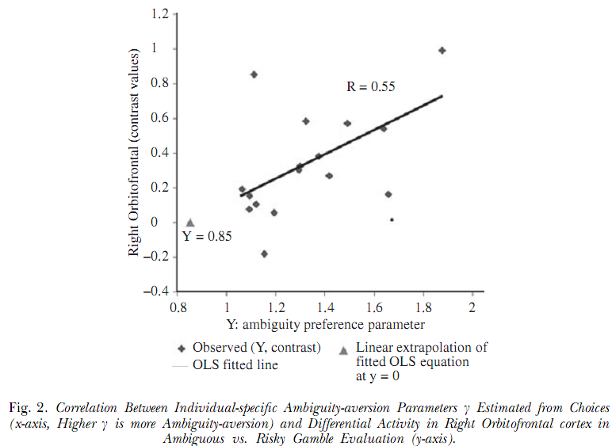
Evidence for New Psychological Variables
OFC activity
NO activity!
Ambiguity Aversion

Slide 27
Evidence for New Psychological Variables
PDR predicts lying in cheap talk games
Wang, Spezio and Camerer (2010)
Disrupting DLPFC with TMS makes you
accept unfair offers in the ultimatum game
Wout et al. (Neuroreport 2005) and Knoch et al (Science 2006)
based on Sanfey et al. (Science 03)
Oxytocin doses increase trust in trust game
Kosfeld et al. (Nature 2005)

Slide 28
Conclusion
Future research
Multiple-process theories of the brain
What is the best dual-self (or triple-self) model?
Can we find these selves in the brain?
Neural evidence of behavioral distinctions
Loss aversion? Emotion for self-image? Framing?
Can state-dependent preference explain this?
Are you aware of these influences on your state?

Slide 29
Conclusion
The Mindless Critique: (In the past,)
Economics is only about making choices.
But:
Why can't we consider intermediate processes?
Neuroeconomics I: How come we chose to develop our brains into its current form?
Response from History of Economic Thought:
If Edgeworth were alive today,
Would he just be making boxes,
Or also recording the brain?

Slide 30
Neuroeconomics: A View from Neuroscience
Montague, Read (2007) Neuroeconomics: A View from Neuroscience. Functional Neurology, 22(4): 219-234.
Holy Grail 1 (from Neuroscience side)
How does neural tissue sustain itself and process information efficiently?
Unlike computers who don’t worry about heat
This is Neuroeconomics I
How economics can help neuroscience!
Just like game theory helping theoretical biology…

Slide 31
Neuroeconomics: A View from Neuroscience
Holy Grail 2 (from Economics side)
Can we find a Theory of the Brain that explains more human behavior?
Like Theory of the Firm in IO
EX: Fudenberg and Levine (2006)
Some already covered above
See Montague (Func. Neuro. 2007) for a consumer's account for this…

Slide 32
Neuroeconomics: Where We Stand?
Bits and pieces are coming together
fMRI (most common/advance) has great spatial resolution (areas of the brain), but
Temporal resolution is still 2 second per scan
Activation is indirect, not causal (only trace hemodynamic blood flow into brain regions)
However, combining several tools gives a much clearer picture

Slide 33
Neuroeconomics: Where We Stand?
Economics can guide experimental design
And can benefit from opening the black box
SPM8 – Matlab Toolbox for fMRI data/GLM
Can you think of a study to do yourself?
Remember, since Imaging data are noisy:
Need 90+ trials per subject (to aggregate)
Need very clean design (treatment vs. control)
Interaction is difficult (typically only 1 scanner)

Slide 34
Recent Advancements
Chen, Nelson and Hsu (2015), From "Where" to "What": Distributed Representations of Brand Associations in the Human Brain. Journal of Marketing Research, Forthcoming.
Saez, Set, and Hsu (2014), From Genes to Behavior: Placing Cognitive Models in the Context of Biological Pathways. Frontiers in Neuroscience.
Zhu, et al. (2014), Damage To Dorsolateral Prefrontal Cortex Affects Tradeoffs Between Honesty And Self-Interest. Nature Neuroscience, 17: 1319-1321.

Slide 35
Recent Advancements
Bertoux et al. (2014), Behavioral variant frontotemporal dementia patients do not succumb to the Allais paradox. Frontiers in Neuroscience.
Set, et al. (2014), Dissociable Contribution Of Prefrontal And Striatal Dopaminergic Genes To Learning In Economic Games. PNAS, 111: 9615-9620.
Smidts, et al. (2014), Advancing Consumer Neuroscience. Marketing Letters.

Slide 36
Recent Advancements
Zhu, Mathewson and Hsu (2012), Dissociable neural representations of reinforcement and belief prediction errors underlie strategic learning, PNAS, 109(5), 1419-1424.
Zhu, Walsh and Hsu (2012), Neuroeconomic measures of social decision-making across the lifespan, Frontiers in Decision Neuroscience, 6:128.
Takahashi, et al. (2012), Honesty mediates the relationship between serotonin and reaction to unfairness, PNAS, 109(11), 4281-4284.
Notes:
http://neuroecon.berkeley.edu/papers/PNAS%202012%20Zhu.pdf
http://www.frontiersin.org/decision_neuroscience/10.3389/fnins.2012.00128/abstract
http://www.pnas.org/content/109/11/4281.full

Slide 37
版權聲明版權聲明
頁碼 | 作品 | 版權標示 | 來源/作者
1-35 |  |  | 國立臺灣大學 經濟學系 王道一 教授
3 | It is an empirical fact that the natural sciences have progressed ……relying as little as possible on the domain of psychology. |  | Vilfredo F.M. Pareto, qtd. in Richard Blundell et.al, Advances in Economics and Econometrics,Vol.2, Cambridge Up, pp.184. 依據著作權法第46、52、65條合理使用
4 | I hesitate to say that men will ever have the means of measuring directly the feelings of the human heart…that we must estimate their comparative amounts. |  | William Stanley Jevons, “The Theory of Political Economy,” Library of Economics and Liberty. http://www.econlib.org/library/YPDBooks/Jevons/jvnPE1.html#Chapter 1 瀏覽日期：2016/1/13 依據著作權法第46、52、65條合理使用
5 | Assumption A should be judged by the accuracy of the predictions P they imply. A (empirically) false assumption A should be tolerated if it makes accurate predictions P |  | Melton Friedman, “The Methodology of Positive Economics,” Essays in Positive Economics, Chicago Up, 1970, pp.16-19. 依據著作權法第46、52、65條合理使用
Notes:
Assumption A should be judged by the accuracy of the predictions P they imply.
A (empirically) false assumption A should be tolerated if it makes accurate predictions P

Slide 38
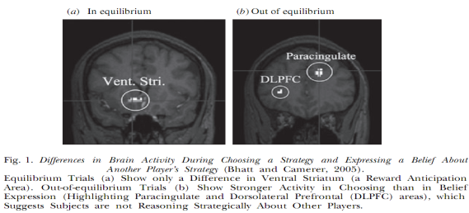
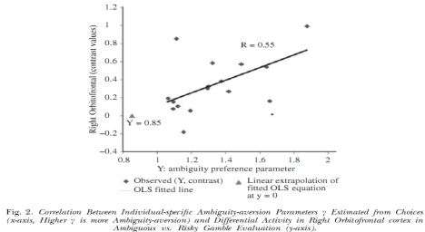
版權聲明版權聲明
頁碼 | 作品 | 版權標示 | 來源/作者
8 | The new theory of the firm replaces the (perennially useful) fiction of a profit-maximizing firm ….interact and communicate to determine firm behavior. |  | Colin Camerer, “Neuroeconomics: Using Neuroscience to make economic predictions,” The Economic Journal, Vol.117,(2007), pp.28. 依據著作權法第46、52、65條合理使用
21 | 1st order beliefs what do you think she will do? 2nd order beliefs what do you think he thinks you will do? |  | Meghana Bhatt and Colin Camerer, “Self-referential thinking and Equilibrium as States of Mind in Games,” Games and Economic Behavior, Vol.52, (2005),pp.456. 依據著作權法第46、52、65條合理使用
22 |  |  | Meghana Bhatt and Colin Camerer, “Self-referential thinking and Equilibrium as States of Mind in Games,” Games and Economic Behavior, No.52, (2005),pp.440 &442. 依據著作權法第46、52、65條合理使用
25 |  |  | Ming Hsu, et al, “Neutral Systems Responding to Degrees of Uncertainty in Human Decision-Making,” Science, Vol.310,(2005), pp.1682. 依據著作權法第46、52、65條合理使用

Slide 39
版權聲明版權聲明
頁碼 | 作品 | 版權標示 | 來源/作者
29 | This is Neuroeconomics I How economics can help neuroscience! Just like game theory helping theoretical biology… |  | P.Montague, “Neuroeconomics: a view form neuroscience,” (2007), Functional Neurology, Vol.27, No.4, (2007),pp.219. 依據著作權法第46、52、65條合理使用

