Slide 1
實驗經濟學一：行為賽局論 Experimental Economics I: Behavioral Game Theory 第一講：實驗經濟學概述 Lecture 1: Experimental Economics and Behavioral Game Theory
授課教師：國立臺灣大學 經濟學系 王道一教授（Joseph Tao-yi Wang ）
本課程指定教材: Colin E. Camerer, Behavioral Game Theory: Experiments in
Strategic Interaction. New York: Russell Sage Foundation; New Jersey:
Princeton UP, 2003.
【本著作除另有註明外，採取創用CC「姓名標示－非商業性－相同方式分享」臺灣3.0版授權釋出】

Slide 2
3 Cores of Economics 經濟學三大核心方法論
Micro, Macro, Metrics (個體，總體，計量)?
Because of 1st year course (因為是博一必修)?
Economic Theory (經濟理論/模型建構)
Mathematical/graphical/verbal models
(數學模型、圖形模型、嘴砲模型)
Data Analysis (資料分析/計量方法)
Statistical methods, graphs (統計方法、製作圖表)
Data Collection (資料取得)
Surveys, experimental methods, requesting data
(問卷調查、實驗方法、索取資料的管道)

Slide 3
Experimental Economics Behavioral Game Theory 實驗經濟學與行為賽局論

Slide 4
What is Experimental Econ? 何謂實驗經濟學？
Science (科學的定義): (Merriam-Webster)
“knowledge or a system of knowledge covering general truths or the operation of general laws especially as obtained and tested through scientific method.”
用來描述普遍真理或普遍法則如何運行的系統性知識，特別是用科學方法獲得與檢驗的知識
What is the “Scientific Method”?
何謂「科學方法」?

Slide 5
Scientific Methods (Wikipedia) 科學方法
The scientific method seeks to explain the events of nature in a reproducible way, and to use these reproductions to make useful predictions. It is done through observation of natural phenomena, and/or through
experimentation that tries to simulate natural events under controlled conditions.
科學方法希望用可重複驗證的方式來解釋自然現象，並用此來做有用的預測。達成方式包含觀察自然發生的現象，以及用實驗在控制條件下產生自然發生的現象。

Slide 6
What is Experimental Econ?何謂實驗經濟學？
Observation (觀察) vs. experimentation (實驗)
Experimental Economics is a method of economics that seeks “experimentation that tries to simulate natural (economic) events under controlled conditions”
實驗經濟學是經濟學的一種研究方法，目的是要「用實驗在控制條件下產生自然
發生的現象」
Other empirical work are “observation of natural (economic) phenomena”
其他實證方法則是「觀察自然發生的經濟現象」

Slide 7
Two Traditions of EE (實驗經濟學兩大傳統)
Two Nobel Laureates of 2002 (兩位諾獎得主)
Vernon Smith (臥龍‧史密斯)
Market Experiments (市場實驗)
Experimental Economics = Economic Science
(實驗經濟學 = (唯一的)經濟科學)
Daniel Kahneman (丹尼‧卡尼曼)
“Psychology and Economics”
aka “Behavioral Economics” (see next slide)
結合心理學與經濟學(又稱「行為經濟學」)
The two traditions interacted and grew…
兩大傳統互相影響、一起成長…

Slide 8
What is Behavioral Econ? 何謂「行為經濟學」
Isn’t Economics by definition Behavioral?
經濟學的目的不就是要解釋人類的行為嗎？
What is “Non-behavioral Economics”?
(到底甚麼算是「非行為經濟學」嗎？)
“Bad” economics? 那應該叫「不好的經濟學」！
Non-behavioral Economics doesn’t exist!
(「非行為經濟學」有定義上的矛盾！)
Though Experimental Economics and Behavioral Game Theory are fine…
「實驗經濟學」與「行為賽局論」沒問題?!

Slide 9
Two Traditions of EE (實驗經濟學兩大傳統)
Market Experiments/Design (市場實驗/設計)
How Adam Smith’s invisible hand really works
(在實際市場中「看不見的手」如何運作)
Behavioral Game Theory (行為賽局論)
What players actually do in games
(在賽局中真實的人如何做決定)
Like the Two Traditions in Economic Theory
(正如經濟理論兩大傳統:)
General Equilibrium Theory (全面均衡理論)
Game Theory (賽局論)

Slide 10
Market Experiments and Market Design
市場實驗與市場設計
The Pit Market (交易坑市場)
Chamberlin (JPE, 1948) 張伯倫
Smith (JPE, 1962) 臥龍‧史密斯
Experiment: Seeing the Invisible Hand
(課堂實驗：發現看不見的手)
Ran in Principles of Microeconomics Class
(在大一經濟學原理有做過)
See instructions (請見實驗說明)
Notes:
明)

Slide 11
Seeing the Invisible Hand (發現看不見的手)

Slide 12
Seeing the Invisible Hand (發現看不見的手)

Slide 13
Seeing the Invisible Hand (發現看不見的手)

Slide 14
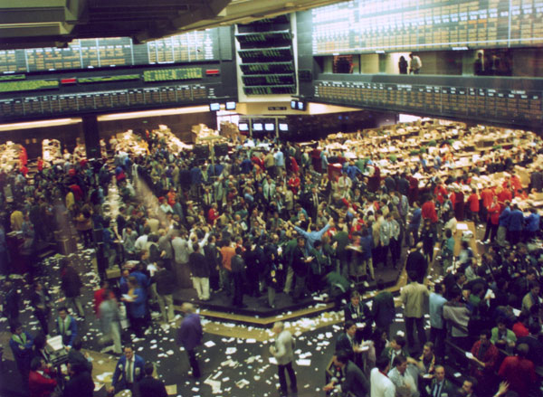
Seeing the Invisible Hand (發現看不見的手)
Prices (成交價格)
07F Economics I 經濟學一
Pit Market (交易坑市場)
A: 6, 6, 6, 8, 5, 6, 6
B: 5, 5, 4, 6, 6, 6, 7
Double Auction (雙邊喊價市場)
A: 5, 5, 5, 5, 5
B: 5, 5, 6, 6, 6
C: 4, 5, 5, 6, 5, 5

Slide 15
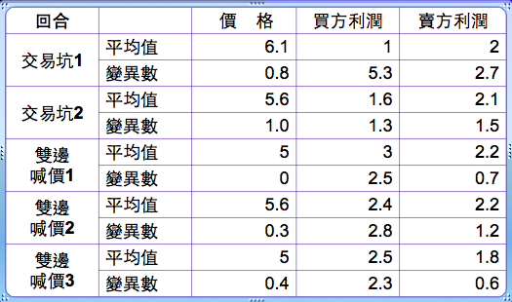
Seeing the Invisible Hand (發現看不見的手)

Slide 16
Seeing the Invisible Hand (發現看不見的手)
Pit Market (交易坑市場) 1: 5, 6, 5, 3, 8, 8, 8
Pit Market (交易坑市場) 2: 6, 4, 8, 4, 6, 7, 7, 7, 5
(08S Experimental Economics
實驗經濟學)

Slide 17
Seeing the Invisible Hand (發現看不見的手)
Double Auction (雙邊喊價市場) 1: 6,10, 7, 7, 7, 8, 8, 7
Double Auction (雙邊喊價市場) 2 : 7, 6, 6, 6, 6, 7, 7, 7
(mistake?)

Slide 18
Market Design: Nobel Prize of 2012
市場設計：2012年瑞典央行紀念諾貝爾經濟科學獎得主
Lloyd S. Shapley (夏普利)
Gale-Shapley algorithm finds stable matching in matching markets (提出演算法求配對分發市場的穩定解)
Alvin E. Roth (AER!) (艾文‧羅斯)
Test this in the lab (在「實驗室」中驗證夏普利的理論)
Take this to the field (在「現場」設計穩定配對分發制度)
Medical Residents, School Choice, Kidney Exchange… (實習醫生、學校分發、器官交換市場等等)

Slide 19
Behavioral Game Theory 行為賽局論(大綱)
What is Game Theory Good for?
(賽局論有甚麼用？)
Three Examples (三個例子):
Ultimatum Bargaining (最後通牒談判實驗)
Continental Divide (產業發展分水嶺實驗)
Beauty Contests (選美結果猜測實驗)
Experimental Regularity and Behavioral Game Theory (一致的實驗結果與行為賽局論)
Conclusion (結論)

Slide 20
What is Game Theory? 何謂賽局論？
Game Theory: What happens if people or nations interact. (賽局論研究「人們」互動的結果)
Game (賽局): Taxonomy of strategic situations
需要籌思對策的各種情境
Strategies (策略), Players (參與者), Payoffs (報酬)
Important Milestones (重要里程碑)
GEB: Von Neumann & Morgenstern (1944)
Nash Equilibrium (奈許均衡): Nash (PNAS, 1950)
Asymmetric information as Types (把資訊不透明看作每個人有不同類型): Harsanyi (MS, 1967-68)

Slide 21
What is Game Theory? 何謂賽局論？
Power of game theory: Generality/precision
賽局論能廣泛應用在不同的領域，也能做精確的預測
Analytical Game Theory (數學賽局「論」)
Mathematical derivations of what players with different cognitive capabilities are likely to do
用數學分析不同聰明程度的玩家在不同的賽局採取何種對策
Possible Barrier: Highly mathematical
Bigger Problem (可能的問題是需要很多數學，但更大的問題是)
Based on introspection and guesses, not observations about how people actually play
根據數學家的自我想像與猜測，而非人們實際上怎麼做

Slide 22
What is Behavioral Game Theory?
Von Neumann and Morgenstern (1944):
“Our knowledge of the relevant facts of economics is incomparably smaller than that commanded in physics at the time when mathematization of that subject was achieved…”
「跟物理學(在三百年前)數理化的時候相比，目前我們對於跟經濟學相關的事實和實證結果真的知道太少了！……

Slide 23
What is Behavioral Game Theory?
Von Neumann and Morgenstern (1944):
“It would have been absurd in physics to expect Kepler and Newton without Tycho Brahe---and…
「在物理學上，要是沒有泰谷的天文觀測紀錄，刻卜勒和牛頓不可能寫出行星運動定律。…… 」
“…there is no reason to hope for an easier development in economics.”
「……同樣地，如果沒有足夠資料，經濟學如何有同樣的發展？當然不可能！」

Slide 24
What is Game Theory Good For?賽局有啥用?
Is Game Theory meant to 賽局論可以
Predict what people do, (預測人們的行為)
Explain why people act this ways, (解釋人們的行為)
Advise people what to do? (建議人們該怎麼做)
Case (實例): auction theory & real world auctions
Auction Theory (拍賣理論)
vs. Experimental Evidence (實驗結果)
Auction Theory (拍賣理論)
vs. Real World Auction Design (拍賣制度設計)

Slide 25
Three Examples 三個例子
BGT: what players actually do
(行為賽局論：人們實際怎麼做)
By utilizing results from hundreds of experiments 根據上百個「爾虞我詐」的實驗結果
Ultimatum Bargaining (最後通牒談判實驗)
Beauty Contests (選美結果預測實驗)
Continental Divide (產業發展分水嶺實驗)

Slide 26
Three Examples 三個例子
Goal: Show how BGT can
explain what people do more accurately
by extending game theory to include:
social preferences (fairness),
limited strategic thinking, and
learning.
目的：說明行為賽局論如何更準確預測人們的行為，把社會(公平)偏好、有限理性思考和學習過程引入數學賽局論。

Slide 27
例一：最後通牒談判(Ultimatum Bargaining)
2 players (參與者): Proposer (下通牒的提議者) and Respondent (回應者)
Action of Proposer (提議如何瓜分新台幣100元): First makes a proposal on how to split $100: 10-90, 20-80, 30-70, 40-60, 50-50,...
Act of Respondent (回應接受或拒絕): Accepts or Rejects the proposal.
Outcome (結果): Split accordingly if accept, both get nothing if reject.
(接受則按該提議瓜分100元；拒絕則兩人什麼都沒有)
Photographer vs. Tourist (觀光景點攝影師兜售照片)

Slide 28
例一：最後通牒談判(Ultimatum Bargaining)
AGT Predictions (數學賽局論的預測)
Responders accept any low offer (回應者通通接受)
Proposers offer unfairly (提議者提出極不公平方案)
Experimental Results (實驗結果)
Responders reject unfair offers (回應者拒絕不公平方案)
Proposers often offer fairly (50-50) (提議合理方案)
BGT Explanation: (行為賽局論的解釋)
Negative Reciprocity (你對我不仁，我就對你不義)

Slide 29
例一：最後通牒談判(Ultimatum Bargaining)
Responders do not maximize own earnings
(回應者並非追求自己「物質上」的報酬最大)
Still think strategically (w/ social preferences)
但仍是理性思考，只是有社會偏好、厭惡不公平
Further Investigation (延伸研究): BGT, Ch.2
Primitive societies under different culture of fairness (不同原始部落有不同的公平文化)
Knoch, …, Fehr, Science 2006
TMS your DLPFC to accept unfair offers
用穿顱刺激DLPFC腦區能讓人接受不公平方案

Slide 30
Disneyland Photo Field Experiment 還真的有！
Gneezy et al. (2010), “Shared Social Responsibility: A Field Experiment in Pay-What-You-Want Pricing and Charitable Giving,” Science 329 (5989): 325–327.
Change pricing scheme of photo taken at a Disneyland ride (on different days)
Fixed US$12.95 vs. Pay-What-You-Want
Nothing to Charity vs. 50% to Charity*

Slide 31
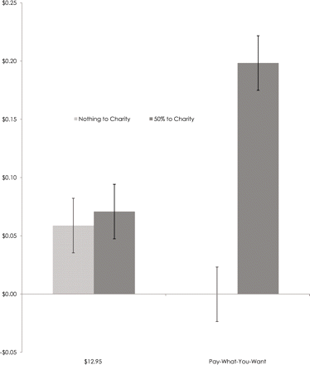
Fig.1 Profit per rider (amount paid minus production costs)
Problem: This is profit only because Disney did not really donate more money to charity!
Instead reduced regular donations by the same amount!
Likely to change results if disclosed...

Slide 32
例二：選美結果預測賽局(p-Beauty Contest)
Newspaper shows 6 pictures
Choose one picture and win a prize if
you chose the most chosen picture
凱因斯認為股票市場就像報紙預測選美結果：
“It is not a case of choosing those which, to the best
of one’s judgment, are really the prettiest,
nor even those which average opinion genuinely thinks
the prettiest.
「這不是要挑每個人各自認為最漂亮的[臉蛋]，
更不是要挑大家公認最漂亮的。

Slide 33
例二：選美結果預測賽局(p-Beauty Contest)
We have reached the third degree, where we
devote our intelligences to
anticipating what average opinion expects the
average opinion to be.
我們已經想到第三層去，
努力預測一般人心目中認為大家公認最漂亮的會是誰。
And there are some, I believe, who practice the fourth,
fifth, and higher degrees.”
而且我相信有些人還可以想到第四層、第五層或更高。」
Keynes (1936)

Slide 34
例二：選美結果預測賽局(p-Beauty Contest)
p-Beauty Contest (Guessing Game)
選美結果預測賽局，又稱「猜測(平均的三分之二)賽局」
Environment (遊戲規則): N players (參與者)
Action of Player (參與者的策略): Each player guess a number from 0-100
每一位參與者都猜一個0-100數字
Outcome (結果): Number closest to p=2/3 of the average wins
所猜數字最接近所有猜測數字的平均乘p=2/3的人就是贏家

Slide 35
例二：選美結果預測賽局(p-Beauty Contest)
Each pick 0-100 to predict 2/3 of the average
AGT Predictions (數學賽局論的預測)
Unique Nash: Choose 0 (dominant solvable)
不斷地刪除劣勢策略可解出唯一的Nash均衡(大家都選0)
Experimental Results (實驗結果)
First-round choices (首次平均) around 21-40
Converge to 0 within 10 rounds (十回合內到均衡)
BGT Explanation: (行為賽局論的解釋)
Limited iterated reasoning (level-k; 多層次思考)
Learning: Towards equilibrium (學習「到」均衡)
Notes:
35

Slide 36
Results from 2008 課堂實驗結果
Average = 27.75
Target = 18.5
Exclude 3 obs.
Average = 20.93
Target = 13.95
Notes:
36

Slide 37
例三：產業發展分水嶺 (Continental Divide)
Location Problem: Silicon Valley or Hollywood?
7 a group, each choose 1-14 (一組七人，各選1-14)
Payoff based on your choice & group median
你的報酬取決於你的數字和所有人的中位數(報酬矩陣見下表)
Key Feature: (別人選小你也該選小、別人選大你也該選大)
Should pick low if others pick low
Should pick high if others pick high
When everyone is going to China, Hsinchu Science Park, etc. will you follow the trend?
當大家都在竹科(或東莞？)設廠，你會獨排眾議，還是隨波逐流？

Slide 38
例三：產業發展分水嶺 (Continental Divide)
 | 3 | 4 | 5 | 6 | 7 | 8 | 9 | 10 | 11 | 12
3 | 60 | 66 | 70 | 74 | 72 | 1 | -20 | -32 | -41 | -48
4 | 58 | 65 | 71 | 77 | 80 | 26 | 8 | -2 | -9 | -14
5 | 52 | 60 | 69 | 77 | 83 | 46 | 32 | 25 | 19 | 15
6 | 42 | 52 | 62 | 72 | 82 | 62 | 53 | 47 | 43 | 41
7 | 28 | 40 | 51 | 64 | 78 | 75 | 69 | 66 | 64 | 63
8 | 11 | 23 | 37 | 51 | 69 | 83 | 81 | 80 | 80 | 80
9 | -11 | 3 | 18 | 35 | 57 | 88 | 89 | 91 | 92 | 94
10 | -37 | -21 | -4 | 15 | 40 | 89 | 94 | 98 | 101 | 104
11 | -66 | -49 | -31 | -9 | 20 | 85 | 94 | 100 | 105 | 110
12 | -100 | -82 | -61 | -37 | -5 | 78 | 91 | 99 | 106 | 112

Slide 39
例三：產業發展分水嶺 (Continental Divide)
 | 3 | 4 | 5 | 6 | 7 | 8 | 9 | 10 | 11 | 12
3 | 60 | 66 | 70 | 74 | 72 | 1 | -20 | -32 | -41 | -48
4 | 58 | 65 | 71 | 77 | 80 | 26 | 8 | -2 | -9 | -14
5 | 52 | 60 | 69 | 77 | 83 | 46 | 32 | 25 | 19 | 15
6 | 42 | 52 | 62 | 72 | 82 | 62 | 53 | 47 | 43 | 41
7 | 28 | 40 | 51 | 64 | 78 | 75 | 69 | 66 | 64 | 63
8 | 11 | 23 | 37 | 51 | 69 | 83 | 81 | 80 | 80 | 80
9 | -11 | 3 | 18 | 35 | 57 | 88 | 89 | 91 | 92 | 94
10 | -37 | -21 | -4 | 15 | 40 | 89 | 94 | 98 | 101 | 104
11 | -66 | -49 | -31 | -9 | 20 | 85 | 94 | 100 | 105 | 110
12 | -100 | -82 | -61 | -37 | -5 | 78 | 91 | 99 | 106 | 112

Slide 40
例三：產業發展分水嶺 (Continental Divide)
AGT Predictions (數學賽局論的預測)
Multiple Equilibrium (兩個均衡): 3 or 12
Experimental Results (實驗結果)
Don’t always gravitate toward Good Eq.
Small history accidents have big LR impact
重複多次不見得會到較好的均衡、歷史的偶然對長期發展有重大影響
BGT Explanation (行為賽局論的解釋)
Learning in the basin of attraction
Initial Conditions: Lucky 7 vs. 8 (一路發)?
在「引力範圍」內被牽引，初始條件： Lucky 7 vs. 8 (一路發)

Slide 41
Experimental Regularity 有一致的結果，然後？
Goal: Improve game theory by establishing regularity and inspiring new theory
目的：改進賽局論(而非推翻)，用一致的結果激發新理論
Why has empirical observation played a small role in game theory until recently?
為何實證觀察直到最近才對賽局論有影響？
John Nash did experiments at RAND
奈許本人其實有嘗試跟蘭德智庫一起做賽局實驗，但是…
“Unbelievable” PD results?!
沒有進一步發展是因為囚犯兩難的實驗結果「難以置信」？

Slide 42
Experimental Regularity 有一致的結果，然後？
How others react to (experimental) data?
關於實驗方法的反對意見：
People are confused, not motivated
人們搞錯了、沒誘因？好的實驗設計可克服、讓決策有真實後果
Experimental designs are all bad
實驗設計都很糟？民主政治是最糟的政治制度，但其他更不可行
People were playing a different game
人們其實在做別的？也許是「美麗人生」，但as-if 模型都如此
Non-rational behavior cannot be modeled
非理性就是亂選？但非理性行為仍可預測(Predictably Irrational)

Slide 43
Conclusion 結論
AGT → Experimental Regularities → BGT
數學賽局論→看到一致的實驗結果→行為賽局論
Three Examples (三個例子)
Want to see more? (更多請見)
Camerer (2003), Behavioral Game Theory
Homework:
Read BGT, Ch.1 and Lecture notes (both online)
Solve the equilibrium of the 3 examples above
你能解出上述三個例子的均衡嗎？翻翻大二個經課本吧！

Slide 44
版權聲明版權聲明
頁碼 | 作品 | 版權標示 | 來源/作者
1-43 |  |  | 國立臺灣大學 經濟學系 王道一 教授
4 | Science : knowledge or a system of knowledge covering general truths or the operation of general laws especially as obtained and tested through scientific method |  | Sience / Merrian-Webster Online Dictionary http://www.merriam-webster.com/dictionary/science 瀏覽日期: 2015/9/20 依據著作權法第46、52、65條合理使用
5 | The scientific method seeks to explain the events of nature in a reproducible way . . . or through experimentation that tries to simulate natural events under controlled conditions. |  | Scientific method / wikipedia https://en.wikipedia.org/wiki/Scientific_method 瀏覽日期: 2015/9/20 本作品採創用CC 「姓名標示-相同方式分享」3.0未本地化版授權釋出
11 |  |  | 國立臺灣大學 經濟學系 王道一 教授

Slide 45
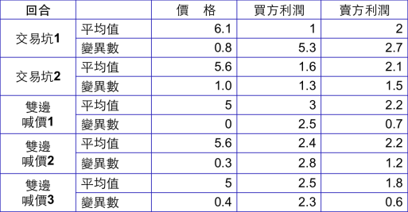
版權聲明版權聲明
頁碼 | 作品 | 版權標示 | 來源/作者
12 |  |  | 國立臺灣大學 經濟學系 王道一 教授
13 |  |  | 國立臺灣大學 經濟學系 王道一 教授
14 |  |  | Chicago Bot.Wiki Commons/user: Leslie/ creator: Jeremy Kemp (https://commons.wikimedia.org/wiki/File:Chicago_bot.jpg) 瀏覽日期: 2015/9/20 本作品屬公共領域之著作
15 |  |  | 國立臺灣大學 經濟學系 王道一 教授

Slide 46
版權聲明版權聲明
頁碼 | 作品 | 版權標示 | 來源/作者
16 |  |  | 國立臺灣大學 經濟學系 王道一 教授
17 |  |  | 國立臺灣大學 經濟學系 王道一 教授
18 | Gale-Shapley algorithm finds stable matching in matching markets |  | D. Gale and L. S. Shapley, “College Admissions and the Stability of Marriage.” The American Mathematical Monthly, Vol. 69, NO. 1(Jan., 1962), pp. 9-15. 依據著作權法第46、52、65條合理使用
18 | Test… Kidney Exchange |  | A.E Roth and MAO Sotomayor, Two Sided Matching: A Study in Game-Theoretic Model and Analysis. New York: Cambridge UP, 1992. 依據著作權法第46、52、65條合理使用

Slide 47
版權聲明版權聲明
頁碼 | 作品 | 版權標示 | 來源/作者
21 | Based on introspection and guesses, not observations about how people actually play |  | Colin E. Camerer, Behavioral Game Theory: Experiments in Strategic Interaction. New York: Russell Sage Foundation; New Jersey: Princeton UP, 2003. Pp. 5 依據著作權法第46、52、65條合理使用
22 | Our knowledge of the relevant facts of economics is incomparably smaller than that commanded in physics at the time … |  | J. von Neumann and Oskar Morgenstern, Theory of Games and Economic Behavior. Princeton: Princeton UP, 1944. Pp. 4. 依據著作權法第46、52、65條合理使用
23 | It would have been absurd in physics to expect Kepler and Newton without Tycho Brahe---and… there is no reason to hope … |  | J. von Neumann and Oskar Morgenstern, Theory of Games and Economic Behavior. Princeton: Princeton UP, 1944. Pp. 4. 依據著作權法第46、52、65條合理使用
24 | Auction Theory . . . Auction Design |  | 由王道一教授整理自 1.Colin E. Camerer, Behavioral Game Theory: Experiments in Strategic Interaction. New York: Russell Sage Foundation; New Jersey: Princeton UP, 2003. Pp. 6 2. Paul R. Milgrom, Putting Auction Theory to Work. New York: Cambridge UP, 2004. 依據著作權法第46、52、65條合理使用

Slide 48
版權聲明版權聲明
頁碼 | 作品 | 版權標示 | 來源/作者
27 | Two player . . . Both getting rejected |  | Colin E. Camerer, Behavioral Game Theory: Experiments in Strategic Interaction. New York: Russell Sage Foundation; New Jersey: Princeton UP, 2003. Pp. 8-9 依據著作權法第46、52、65條合理使用
29 | Primitive societies under different culture of fairness |  | J. Henrich et al., “In Search of Homo Economicus: Behavioral Experiments in 15 Small- Scale Society.” The American Economic Review Vol.91, No.2(May, 2001), Pp. 73-78 依據著作權法第46、52、65條合理使用
29 | TMS your DLPFC to accept unfair offers |  | Daria Knoch et al., “Diminishing Reciprocal Fairness by Disrupting the Right Prefrontal Cortex.” Science, Vol. 314, No. 580 (October 2006), Pp. 829-832. 依據著作權法第46、52、65條合理使用
31 |  |  | Gneezy et al., “Shared Social Responsibility: A Field Experiment in Pay-What-You-Want Pricing and Charitable Giving,” Science Vol.329, No. 5989 (July 2010), Pp. 326 由所有人授權，您如須利用本作品，請另行向權利人取得授權。

Slide 49
版權聲明版權聲明
頁碼 | 作品 | 版權標示 | 來源/作者
32 | It is not a case of choosing those which, to the best of one’s judgment, are really the prettiest, nor even those which average opinion genuinely thinks the prettiest |  | J.M. Keynes, “The General Theory of Employment, Interest, and Money, A Project Gutenberg of Australian ebook. (http://gutenberg.net.au/ebooks03/0300071h/printall.html) 瀏覽日期：2015/9/20
33 | We have reached the third degree, where we devote our intelligences to anticipating what average opinion expects the average opinion to be. And there are some, I believe, who practice the fourth, fifth, and higher degrees.” |  | J.M. Keynes, “The General Theory of Employment, Interest, and Money, A Project Gutenberg of Australian ebook. (http://gutenberg.net.au/ebooks03/0300071h/printall.html) 瀏覽日期：2015/9/20
34 | p-beauty contest…就是贏家 |  | Colin E. Camerer, Behavioral Game Theory: Experiments in Strategic Interaction. New York: Russell Sage Foundation; New Jersey: Princeton UP, 2003. Pp. 16 依據著作權法第46、52、65條合理使用
36 |  |  | 國立臺灣大學 經濟學系 王道一 教授

Slide 50
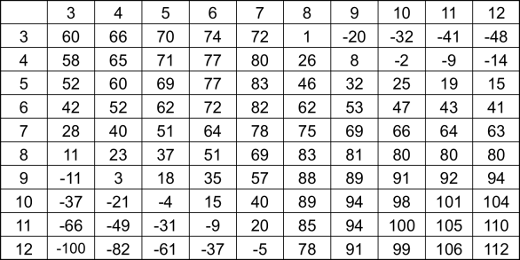
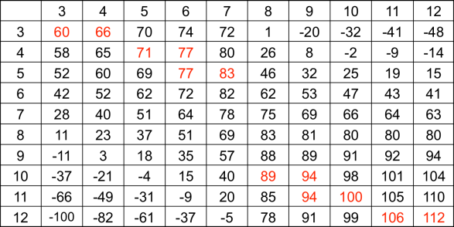
版權聲明版權聲明
頁碼 | 作品 | 版權標示 | 來源/作者
37 | Location Problem … pick high. |  | Colin E. Camerer, Behavioral Game Theory: Experiments in Strategic Interaction. New York: Russell Sage Foundation; New Jersey: Princeton UP, 2003. Pp. 12-13 依據著作權法第46、52、65條合理使用
38 |  |  | 國立臺灣大學 經濟學系 王道一 教授
39 |  |  | 國立臺灣大學 經濟學系 王道一 教授
41 | Why has… PD results? |  | 由王道一教授整理自 1.Colin E. Camerer, Behavioral Game Theory: Experiments in Strategic Interaction. New York: Russell Sage Foundation; New Jersey: Princeton UP, 2003. Pp. 21 2 Sylvia Nasar. A Beautiful Mind: A Biography of John Forbes Nash Jr. New York: Simon & Schuster, 1998. 依據著作權法第46、52、65條合理使用

