Slide 1
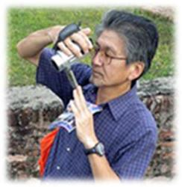
Taiwan and Southeast Asian Arts Vol.1 臺灣與東南亞藝術 第1回
Sakai Takashi 坂井 隆
Institute of Art History, National Taiwan University
國立臺灣大學藝術史研究所
Ph.D., Sophia University, Japan
Research interests:
History of Southeast Asian Art
Archaeology of Southeast Asian
National Taiwan University Sakai Takashi
Unless noted, the course materials are licensed under Creative Commons
Attribution-NonCommercial-ShareAlike 2.5 Taiwan (CC BY-NC-SA 2.5)

Slide 2
Taiwan & Southeast Asian Arts
1a. Where is Southeast Asia?
1b. What is arts?
2. Present relation Taiwan and ‘Southeast Asia’
3. Term Paper
Notes:
My name is Sakai Takashi and I am from Japan. In this course I will teach you about cultural relationship between Taiwan and Southeast Asia.[In this first class, I will introduce the course and the relationship between Taiwan and its neighbors. / As this my first time teaching this course, I can only give you a basic introduction to understanding the relationship between Taiwan and its neighbors.]

Slide 3
1a. Where is Southeast Asia?
「對於東南亞(Southeast Asia)，直言不諱，除了新加坡(Singapore)較為進步，其他國家我的印象是貧困、落後、衛生環境差、政治動亂，還有外籍勞工、外籍新娘等負面的想法。」(a NTU student term paper)
‘Taiwan is out of Southeast Asia where has several negative image such as poor, backwardness, unsanitary, instability, and foreign workers, foreign bride.’
Notes:
Last semester when I read one of my student’s term paper, I was surprised by this student’s impression of Southeast Asia. This student had many negative images of Southeast Asia such as poor, backward, unsanitary, politically unstable, and certainly he[/she] is thinking that his own identity is in opposition to Southeast Asia. But it is also interesting that he[/she] also acknowledged the existence of foreign laborers and foreign brides [same negative one for this student in Taiwan?]
[slide text: As for Southeast Asia, to be honest, other than Singapore which is fairly developed, my impression of the other countries is that they are poor, backward, unsanitary, politically unstable; also, negative images like foreign laborers and foreign brides come to mind.]

Slide 4
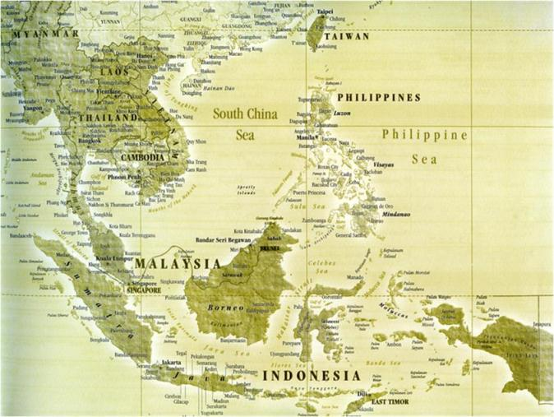
1a. Where is Southeast Asia?
ASEAN
Area of Southeast Asia by ASEAN
Notes:
This map was made by the ASEAN Committee on Culture and Information; so, the names of all the nations in Southeast Asia were written in [capital letters/all caps/block script]. It is very clear that name of Taiwan was written in the same script as the other countries in this area. For ASEAN, Taiwan naturally belongs in their area. This thinking is used not only by ASEAN but also large part of scholars in the world. At least geographically, Taiwan is part of Southeast Asia.

Slide 5
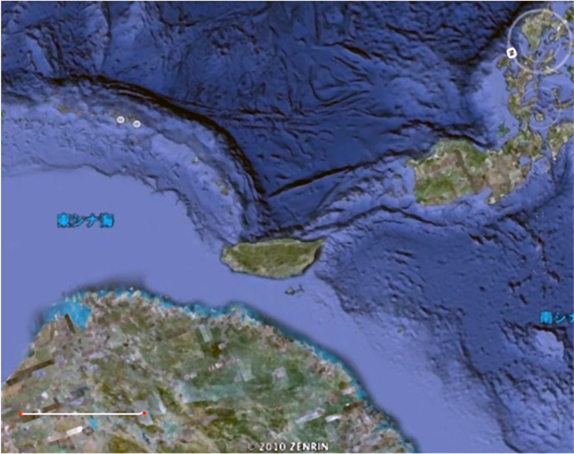
1a. Where is Southeast Asia?
Okinawa
Philippines
Fujian（福建）
Google Earth
Neighboring of Taiwan
Notes:
Taiwan Island is located at the intersection of sea routes of three areas. In this map, we can easily see that Taiwan has 3 neighbors: Fujian in China, the Okinawa Islands in Japan and the Philippines. Also, the distance to the Main Island of Okinawa is slightly longer than distance to north end of Luzon Island. In any case, the Philippines is one of Taiwan’s neighbors. In any place in the world, knowledge of neighboring countries is very useful for discovering ones’s own cultural and historical background.

Slide 6
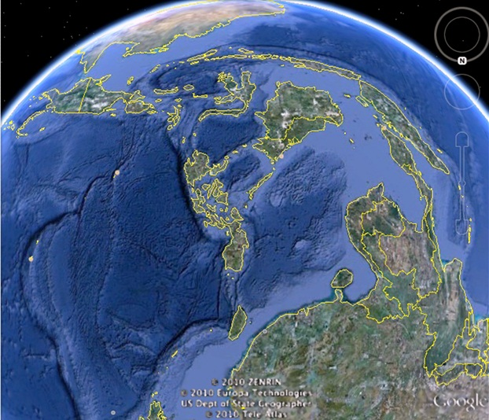
1a. Where is Southeast Asia?
Luzon
Taiwan
Okinawa
Southeast Asian Islands
Google Earth
Notes:
If we look at a more wide scale map such as this picture, the position of Taiwan Island becomes very clear. It become the one of points of the large triangle formed by the archipelago of Southeast Asia. From southern end of Taiwan, if we have [long distance perspectives, it could be seen all of this archipelago area.]

Slide 7
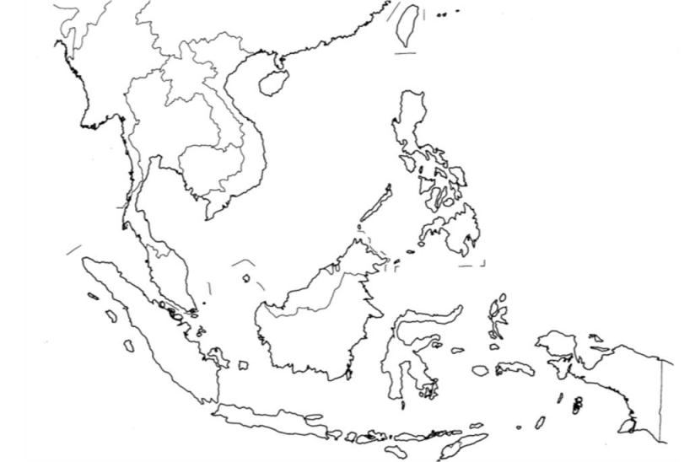
1a. Where is Southeast Asia?
Chinese
Influence
European
Influence
Indian Influence
National Taiwan University Sakai Takashi
Notes:
In historical and cultural context, large parts of Southeast Asia were heavily influences by India, as can been seen large religions such as Buddhism, Hinduism and Islam. However, in several areas located far from India, the influence of the Indian culture is not deep. Among such non-Indian influenced area, one commonality is the influence of Chinese culture both in Northern Vietnam and Taiwan, as well as European influence in both the Philippines and Taiwan. Taiwan and the Philippines also have something else in common: there is long history of South Fujianese migration to both areas.

Slide 8
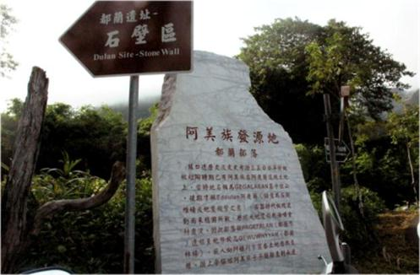
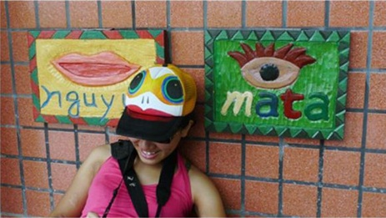
1a. Where is Southeast Asia?
National Taiwan University Sakai Takashi
Home land of Ami people
Ami word education
National Taiwan University Sakai Takashi
Notes:
[As the other things,]Taiwan has another clear Southeast Asian element. The picture on the left shows the homeland of Ami people, an aboriginal [people/tribe] in Taiwan. The picture on the right shows us the condition of Ami language education in a school in this area, near Taidong. It is easy to understand that the word on the right tile, ‘mata,’ means eye. This Ami word is exactly same in Indonesian. Both languages belong to the same Austronesian language family.

Slide 9
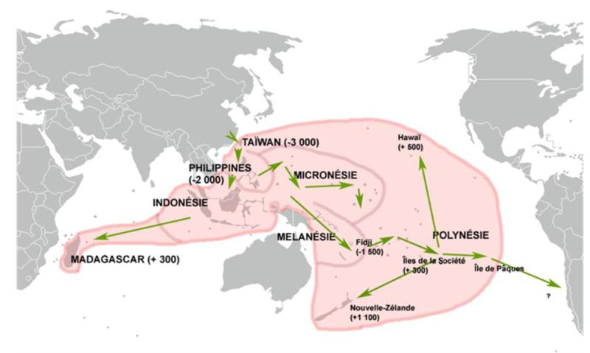
1a. Where is Southeast Asia?
Wiki Maulucioni
Migration of Austronesian peoples
Notes:
This map show you the long distance migration of Austranesian peoples across a wide area, including Southeast Asia, the Pacific Ocean and the Indian Ocean too. Presently, the majority of scholars agree that such a very wide migration of Austronasian peoples was started from Taiwan in around 3,000 BC. The common ancestor of these wide spread peoples in this pink-shade area lived in Taiwan.

Slide 10
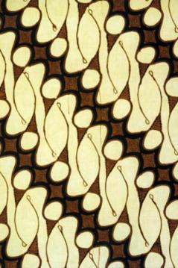
1b. What is Arts?
Arts: the result of fine human activities
1.technique, 2.creation by imagination
1. variation of technique for making culture
2. expression of spiritual/religious feeling
Kinds of Arts: textiles (cloth), cuisine (eating), architectures (residence), performing arts (dance, music, theater etc.: religion), plastic arts (sculpture, ceramics etc.: religion)
Arts for understanding of historical cultural condition
Pepin Van Roojen
Indonesian traditional textile
Notes:
The main subject of this course is arts. Usually, this word brings up certain images such as paintings, ceramics or sculptures. But such categories, commonly exhibited in museums, are only a part of the narrow definition of arts. In English, “arts” means the result of fine human activities, and it was formed in 2 ways: [variation of technique for making culture?] and expression of spiritual/religious feeling. Based on such an understanding, arts consist mainly of textiles, cuisine, architecture, performing arts and plastic arts. This picture shows a Indonesian traditional textile, and certainly this is also a result of arts. Through a knowledge of such a broad definition of arts, we will reach an understanding of the historical and cultural condition of each people.

Slide 11
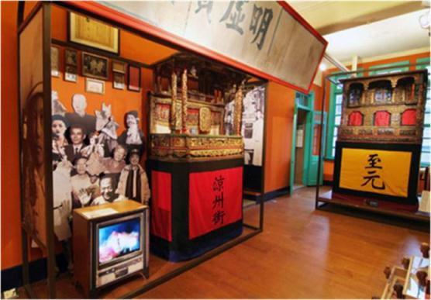
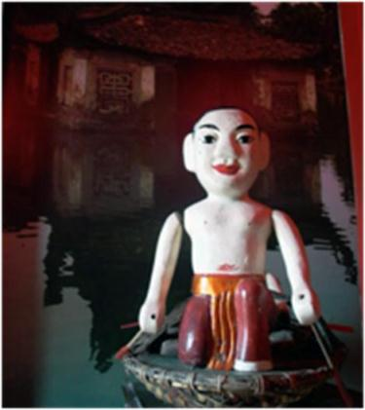
1b. What is Arts?
Lin Liu-Hsin Puppet Theatre Museum
Taipei Puppet Theater Museum
Lin Liu-Hsin Puppet Theatre Museum
Vietnamese water surface puppet in TPTM
Notes:
This is the Taipei Puppet Theater Museum, a very unique museum in Taiwan. This museum exhibits not only Taiwanese traditional puppet theater as in the left picture, but also other Asian puppet theaters such as Vietnamese water puppet theater in the right picture. I think this kind of performing arts is an important element of cultural condition of each peoples because at the same time many people can receive similar feeling in each of their hearts. And by exhibits of this museum, we are able to feel similar thinking in another area of Asia. By such condition, I think this small museum serves a very large purpose in our understanding of Asian cultures.

Slide 12
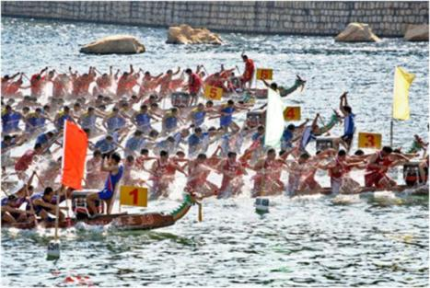
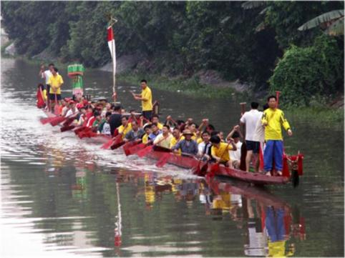
1b. What is Arts?
WiKi Iidxplus
Dragon boat race in Macau
Wiki user : Earthengine
Dagon boat in Guangdong
Notes:
These two pictures are shown us dragon boat races in Guangdong and Macau. As in Taiwan, this narrow boat race is usually performed on each Duanwu Festival. Almost anywhere there are overseas Chinese one can see similar scenes. But originally this boat race is not [only from/from] the Chinese cultural tradition. [Now] we can see similar boat races in the continental area of Southeast Asia, such as Thailand, Lao and Cambodia.

Slide 13
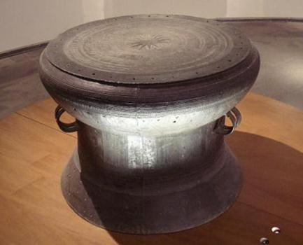
1b. What is Arts?
Bronze drum of pre-history period in Vietnam
Wiki PHGCOM
Boat motif on bronze drum
National Taiwan University Sakai Takashi
Notes:
The dragon boat race is related to the ancient traditions of Southeast Asian culture. This upper picture is one of an ancient bronze drum, which was a symbolic cultural tool in pre-historic Vietnam. On the surface of this bronze drum, one can see many kinds of unique relief images. Among them, on the upper part of the side are boats in relief such as in the lower drawing. On this boat there are many standing people who are wearing bird feathers as a head decoration. Usually this boat relief is interpreted as a special ceremony of boat racing in a river. By this ancient evidence, we can see that the dragon boat race is not uniquely Chinese but a widespread tradition among southern part of China and continental Southeast Asia.

Slide 14
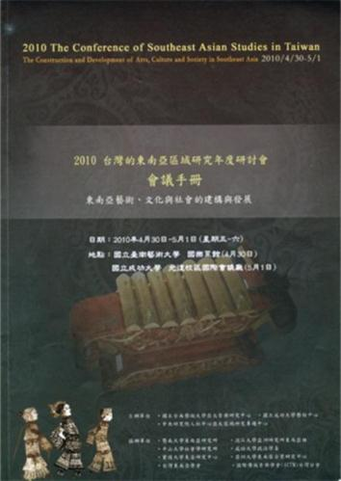
2. Present relation Taiwan and ‘Southeast Asia’
‘Be a Mistress of a Taiwanese businessman: The Patterns and Experiences of Vietnamese Mistress’
Southeast Asia Religious Tradition and Inheritance under transnational marriage 「東南亞跨國婚姻下的宗教傅統與傳承」
Micro-economy of Taiwan-Vietnam Cross-border Marriages 台灣越配微型經濟
Taiwanese Merchants in Vietnam 台商在越南
Southeast Asia Immigrates in Taiwan/ The taste of Southeast Asians 東南亞移民在台灣／東南亞滋味
Research Center of Asia-Pacific Music
Tainan National University of the Arts
Rare study topics and panels in other country
2010 the conference of Southeast Asian Studies in Taiwan
Notes:
In present times, Taiwan has very deep relationship with [the rest of] ‘Southeast Asia’ in both the economic external context and the social internal context. As the result, in 2010 Conference of Southeast Asian Studies in Taiwan, held in Tainan, there were many [rare?] panel topics on other countries, such as Mistresses of Taiwanese Businessmen in Vietnam, Religion and Tradition in International Marriages in Southeast Asia, the Micro-economy of Vietnamese Wives in Taiwan, [Southeast Asian migrants in Taiwan (not on slide)], Taiwanese Businessmen in Vietnam and Southeast Asian tastes in Taiwan. These panel topics show us that presently Taiwan has already become a part of Southeast Asia.

Slide 15
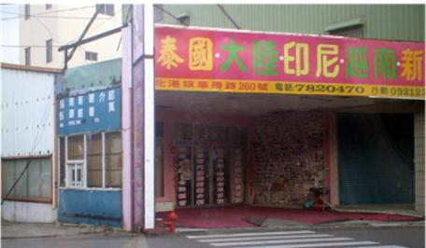
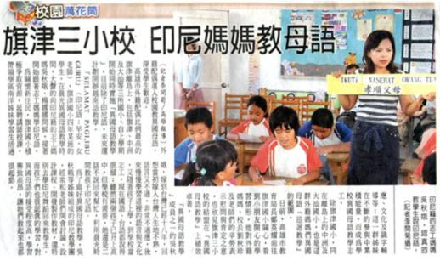
2. Present relation Taiwan and ‘Southeast Asia’
New marriage comers
National Taiwan University Sakai Takashi
The Liberty Times 2007.9.17
Notes:
These two pictures are good illustrations of this situation. Foreign marriage to a Southeast Asian female is not a rare choice for Taiwanese males; so, we can easily find advertisements for intermediaries for foreign marriages. As the result, many mixed blood children have been born, causing a communication gap between the Southeast Asian origin mother and Taiwan-born children, including language.

Slide 16
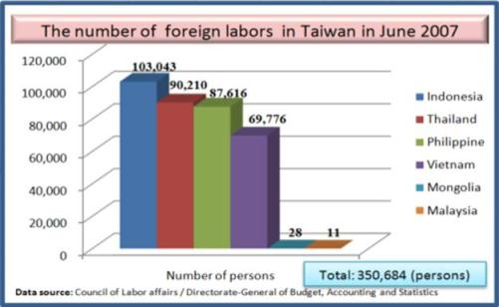
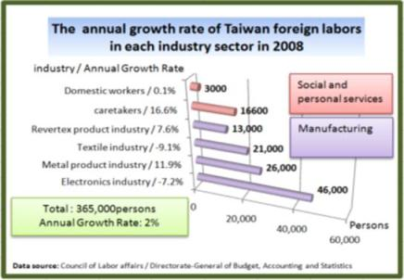
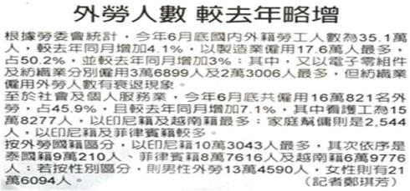
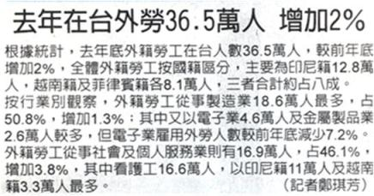
2. Present relation Taiwan and ‘Southeast Asia’
The Liberty Times 2007.9.16
The Liberty Times 2007.9.16
Notes:
Besides marriage, due to Taiwanese government policies, Southeast Asian laborers are already common in Taiwan. The total number of contract laborers from 4 countries of Southeast Asia; Indonesia, Thailand, Philippines and Vietnam; is now close to 400,000. Their number comprises over 1.5% of the total population of Taiwan. Similar situations are occurring in the other developed Asian countries such as Japan, Korea or Singapore, however the largest percentage of permitted Southeast Asian labors in total population is found in Taiwan. And by profession, Taiwan has the most Southeast Asian labors in the nursing care field.

Slide 17
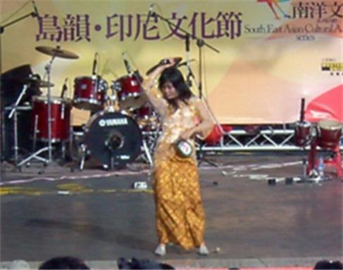
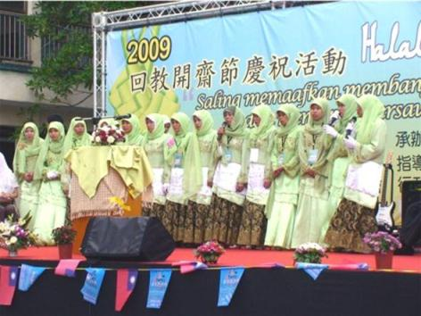
2. Present relation Taiwan and ‘Southeast Asia’
National Taiwan University Sakai Takashi
Indonesian Cultural Festival in 2007
National Taiwan University Sakai Takashi
2009 Festival of Eid ul Fitr
(festival of the Purification After Completing
the Fasting Month)
Notes:
The existence of such Southeast Asian laborers in Taiwan is easy to find in any places in Taiwan. These pictures show us the annual cultural festival of Indonesian Muslims in Taipei, which was sponsored by Central and City governments. Besides Southeast Asians coming for marriage, the laborers are authorized in limited numbers by the government as the latest newcomers in Taiwanese society.
[for caption on right, I would say: “2009 Eid a Fitr Festival/Purification festival at the end of Ramadan, the month of fasting.” Due to increasing contacts with the Islamic world, everyone in the West knows about Ramadan, just not Eid]

Slide 18
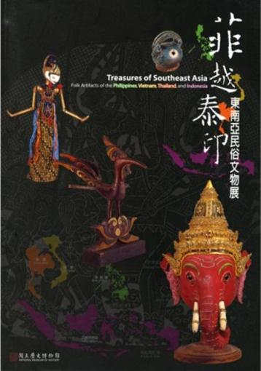
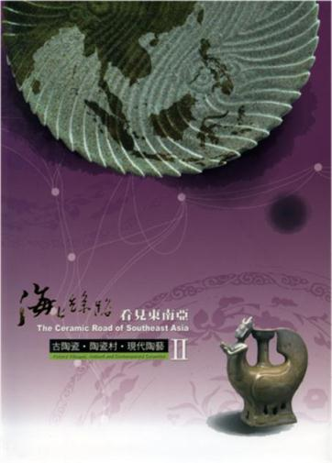
2. Present relation Taiwan and ‘Southeast Asia’
National History Museum
New Taipei City Yingge Ceramics Museum
Exhibition of National History Museum in 2007
Exhibition of Yingge Ceramic Museum in 2009-10
Notes:
Following such social changes in Taiwan as a mixed cultural society, the government has also started several cultural activities to promote the understanding of different cultures. These pictures show us new special exhibitions of Southeast Asian cultures by two museums. Although it is still doesn’t occupy a large percentage among subjects of the common school education, certainly this kind of activity will be increased in the near future in line with actual social condition in Taiwan.

Slide 19
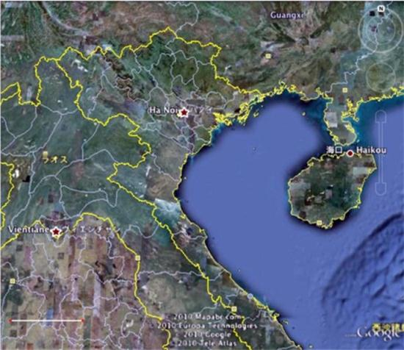
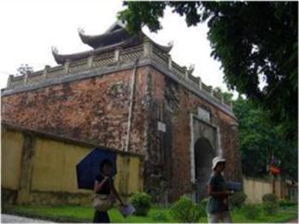
3. Term Paper
Where is Tonkin（東京）?
Tonkin → name of northern area of Viet Nam & gulf of its east side
# original meaning: the east capital
Tonkin
Google Earth
Northeast part of Indochina Peninsula
National Taiwan University Sakai Takashi
The gate of Tanlong Palace in Hanoi
Notes:
However, I should point out that in contrast of such social condition, the general knowledge of Taiwanese students about Southeast Asia is low. One large reason is the result of using Chinese characters for foreign palace names in the education system. For example, the two characters “東京“ are generally used for the capital city of Japan. These characters mean “Eastern Capital.” So, these two characters are also used for the name of Northern Vietnam and the gulf of Northern Vietnam. We should distinguish Tokyo in Japan and Tonkin in Vietnam. In general, learning with proper names in the original language is most simple and best way for understanding of different cultures, especially those of Southeast Asia.

Slide 20
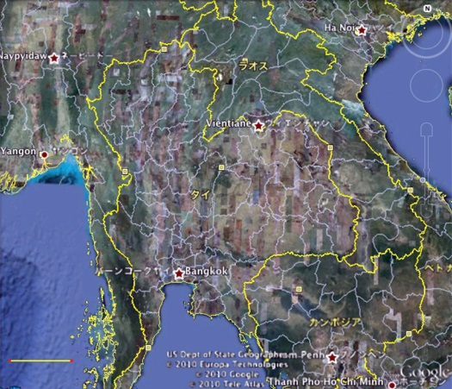
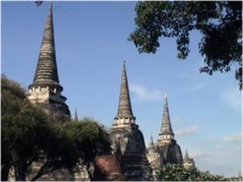
3. Term Paper
Where is Ayutthaya（大城）?
Ayutthaya (old capital of Thailand from 14th to 18th c.)
#original meaning: the capital of Rama (hero of Indian epic Ramayana, and the title of Thai king)
● Ayutthaya
Google Earth
Core part of Indochina Peninsula
National Taiwan University Sakai Takashi
A temple in Ayutthaya
Notes:
A similar example is found in Thailand. Where is the city named with the two Chinese characters “大城?” This has very simple meaning as the “Great City,” but this term only used as the name of the old capital of Thailand during 14th – 18th century. For overseas Chinese, this capital was seen its greatness; however, this capital is known as Ayutthaya in Thai. Because Thai kings are seen as Prince Rama in Indian historical epic Ramayana, this capital was also named as the city of Rama, Ayodhya in India. If only know the city by its name in Chinese characters, you never reach original thinking of the Thai people. This is very simple but important way for understanding different cultures and our own culture.

Slide 21
3. Term Paper
Standard of evaluation
# Knowledge from other source, books or internet, is not important. Show me your own feeling!
Question: announce at December 30th
Requirement
# 1-2 page by A4 paper # Address: sakai@ntu.edu.tw
# Possible to write in English/Chinese/Malay-Indonesian.
# If in Chinese, should be wrote all place name or personal name not by Chinese script but by alphabet.
Exp. Southeast Asia（東南亞）, Vietnam（越南） -1 point Indo-China Peninsula（中南半島） -5 point
Notes:
By same meaning, the use of the term “中南半島“ is large misunderstanding. Both people stayed in Vietnam, Lao, Cambodia, and Thailand as well as the peoples of other areas never used the term of ‘The Southeastern [China] Peninsula’ for to refer to Indo-china Peninsula. Different form 東京 or 大城, this term is not a historical term, but a new one created in China in the 1930s. I believe the thinking each area has its own value, and the position of each culture is equal. If you cannot understand such common thinking, you never understand not only Southeast Asia but also Taiwan itself. From this point of view, we will start to learn about the relation between Taiwan and Southeast Asian arts.

Slide 22
Schedule
no. | mm.dd. | conntents | period | key word | subject 1 | subject 2
1 | 9月16日 | Meaning of Southeast Asia | comtemporary | new commers | areal concept | new migrants
2 | 9月23日 | Colonial architechture1 | Modern | Indo-Saracenic | Japanese buil | British buil
3 | 9月30日 | Colonial architechture2 | Modern | shop-house | laojie | Pinang/Singapore
4 | 10月7日 | special lecture | Pre-modern | Macau | world heritage
5 | 10月14日 | Oversea Chinese culture1 | Modern | Golden Triangle | Yun/Thai meals | Hui
6 | 10月21日 | Oversea Chinese culture2 | Pre-modern | junk trade | 17c | 18c
7 | 10月28日 | Oversea Chinese culture3 | Pre-modern | Zheng He | Islamic relation | Baba-Nyonya
8 | 11月4日 | performing arts | Pre-modern | puppet theater | northern style | southern style
9 | 11月11日 | trade of fine arts1 | Pre-modern | textile trade | cotton | silk
10 | 11月18日 | trade of fine arts2 | Pre-modern | ceramic trade | Southeast Asian | Japanese
11 | 11月25日 | fortifications & city1 | early history | Chinese | Vietnam | Taiwan
12 | 12月2日 | fortifications & city2 | early history | European | Batavia | Zeelandia
13 | 12月9日 | fortifications & city3 | early history | original | Okinawa | Philippine/Buton
14 | 12月16日 | Exchange in Prot-history | Prot-history | lingo-lingo/earring | Vietnam | Philippine/Taiwan
15 | 12月23日 | Austronesian culture1 | Pre-modern | miritime people | outrigger boat | pinisih
16 | 12月30日 | Austronesian culture2 | Pre-history | languages | pinang | tattoo
17 | 1月6日 | Diffusion of Megalithic1 | Pre-history | stone statue | Pacific/SEA | Qilin
18 | 1月13日 | Diffusion of Megalithic2 | Pre-history | sarchophaguses | Bali | Qilin
Notes:
This course is arranged into several fields for exploring the relationship Taiwan and Southeast Asian arts, such as colonial architecture (2 lectures), Overseas Chinese culture (3 lectures), performing arts (1 lecture), trade of fine arts (2 lectures), fortifications & city (3 lectures), the exchange in Proto-history (1 lecture), Austronesian culture (2 lectures) and the diffusion of Megalithic (2 lectures). By these different approaches, we will see the historical and cultural conditions in these areas.

Slide 23
Taiwan and Southeast Asian Arts Vol.1 臺灣與東南亞藝術第一講 Copyright Declaration（版權標示頁）
Sakai Takashi坂井 隆
Institute of Art History , National Taiwan University
（臺大藝術史研究所）

Slide 24
Work | Licensing | Author/Source
 |  | National Taiwan University Sakai Takashi
 |  | Bronwyn Campbell, “Museum Treasures of Southeast Asia”, (Manila : Produced for the ASEAN Committee on Culture and Information, c2002),pp.25. ISBN981-04-7589-6
 |  | Google Earth http://www.google.com/intl/zh-TW/earth/index.html 2011/06/06 visited
 |  | Google Earth http://www.google.com/intl/zh-TW/earth/index.html 2011/06/06 visited
 |  | National Taiwan University Sakai Takashi
 |  | National Taiwan University Sakai Takashi
Notes:
FAIR USE NOTICE: This page may contain copyrighted material the use of which may not be specifically authorized by the copyright owner. ManipurOnline distributes this material without profit to those with an interest in receiving the included information for research and educational purposes. We believe this constitutes a fair useof any such copyrighted material as provided for in 17 U.S.C ß 107. If you wish to use copyrighted material from this site for purposes of your own that go beyond fair use, you must obtain permission from the copyright owner.

Slide 25
Work | Licensing | Author/Source
 |  | National Taiwan University Sakai Takashi
 |  | Wiki Maulucioni http://en.wikipedia.org/wiki/File:Migraciones_austronesias.png 2011/06/07 visited
 |  | Pepin Van Roojen , “Batik design” , Amsterdam : Pepin Press, 1994, pp.58. ISBN90-5496-005-1
 |  | This work is licensed Lin Liu-Hsin Puppet Theatre Museum http://www.taipeipuppet.com/exhibition-02-2.html This work is licensed by Lin Liu-Hsin Puppet Theatre Museum for the use of “Taiwan and Southeast Asian Arts course” ONLY. The copyright belongs to the above mentioned entity and GET does not have the authorization right. Copyright privileges have to be negotiated with the copyright owner(s) for separately. 2011/06/06 visited
 |  | This work is licensed Lin Liu-Hsin Puppet Theatre Museum http://www.taipeipuppet.com/exhibition-04-1.html This work is licensed by Lin Liu-Hsin Puppet Theatre Museum for the use of “Taiwan and Southeast Asian Arts course” ONLY. The copyright belongs to the above mentioned entity and GET does not have the authorization right. Copyright privileges have to be negotiated with the copyright owner(s) for separately. 2011/06/06 visited

Slide 26
Work | Licensing | Author/Source
 |  | WiKi lidxplus http://zh.wikipedia.org/wiki/File:Dragonboat_racing.jpg 2011/06/07 visited
 |  | Wiki user : Earthengine http://zh.wikipedia.org/wiki/File:Dragon_boat_-_Cantonese.JPG 2011/06/07 visited
 |  | Wiki PHGCOM http://en.wikipedia.org/wiki/File:DrumFromSongDaVietnamDongSonIICultureMid1stMilleniumBCEBronze.jpg 2011/06/07 visited
 |  | National Taiwan University Sakai Takashi
 |  | 2010 Annual Conference on Southeast Asian Studies in Taiwan (Research Center of Asia-Pacific Music, Tainan National University of the Arts) (Conference handbook Cover) 2010 「臺灣的東南亞區域研究年度研討會」(國立台南藝術大學亞太音樂研究中心) (會議手冊-封面)
 |  | National Taiwan University Sakai Takashi

Slide 27
Work | Licensing | Author/Source
 |  | The Liberty Times 2007.9.17
 |  | The Liberty Times 2007.9.16
 |  | The Liberty Times 2009.4.1
 |  | National Taiwan University Sakai Takashi
 |  | National Taiwan University Sakai Takashi

Slide 28
Work | Licensing | Author/Source
 |  | This work is licensed by National History Museum for the use of “Taiwan and Southeast Asian Arts course” ONLY. The copyright belongs to the above mentioned entity and GET does not have the authorization right. Copyright privileges have to be negotiated with the copyright owner(s) for separately. Hsieh Shih-chung , Yen Chih-hung, Zhai Zhen-Xiao, 《Treasures of Southeast Asia : Folk Artifacts of the Philippines, Vietnam, Thailand and Indonesia 》 (Taipei: National History Museum, 2007.10.1) (Cover) 謝世忠、嚴智宏、翟振孝，《菲越泰印:東南亞民俗文物展》(台北：國立歷史博物館，2007.10.1)(封面)
 |  | This work is licensed by New Taipei City Yingge Ceramics Museum for the use of “Taiwan and Southeast Asian Arts course” ONLY. The copyright belongs to the above mentioned entity and GET does not have the authorization right. Copyright privileges have to be negotiated with the copyright owner(s) for separately. 謝明良策展主編，《海上絲路 看見東南亞─古陶瓷‧陶瓷村‧現代陶藝II》(台北：新北市立鶯歌陶瓷博物館，2009) (封面)
 |  | National Taiwan University Sakai Takashi
 |  | Google Earth http://www.google.com/intl/zh-TW/earth/index.html 2011/06/06 visited

Slide 29
Work | Licensing | Author/Source
 |  | National Taiwan University Sakai Takashi
 |  | Google Earth http://www.google.com/intl/zh-TW/earth/index.html 2011/06/06 visited

